Slide 1
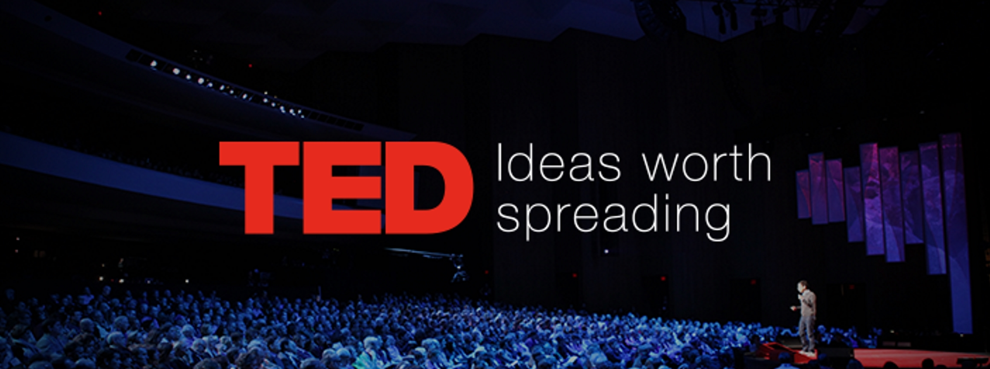
Trend Analysis in TED Talks
By
Nikhil Gudugula
Siddarth Maredu
Sathish Komire

Slide 2

What is a TED Talk and Why Did we choose it?
TED (Technology, Entertainment, Design) is a global platform that hosts a wide range of influential speakers who deliver engaging and thought-provoking talks on diverse topics.
Text Analysis

Slide 3

TED Partnerships
Opportunity to be part of global culture
Not just buying ad space
Lasting relationship

Slide 4



Tools Used
Data Cleaning and filtering
R – Data Wrangling and Analysis
Tableau - Visualization

Slide 5

Data Understanding
#Views
#Comments
Descriptions
Speakers
Titles
Transcripts

Slide 6
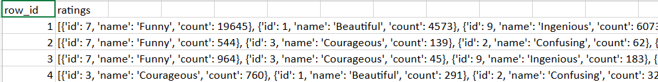
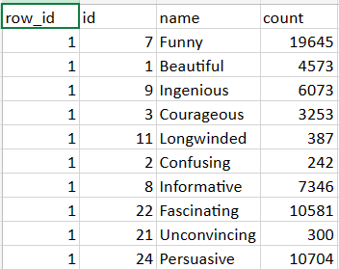
Data Cleaning

Slide 7
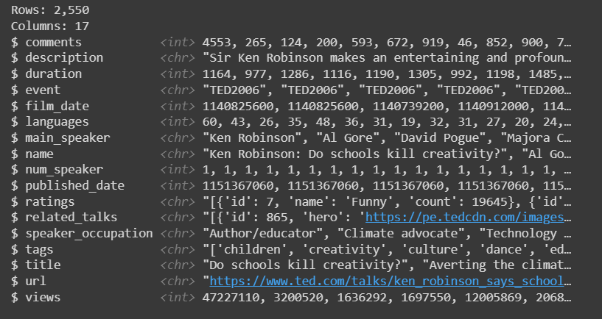
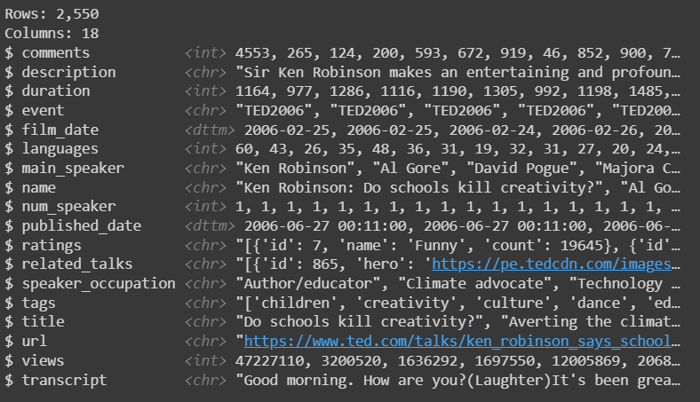
Data Transformation

Slide 8
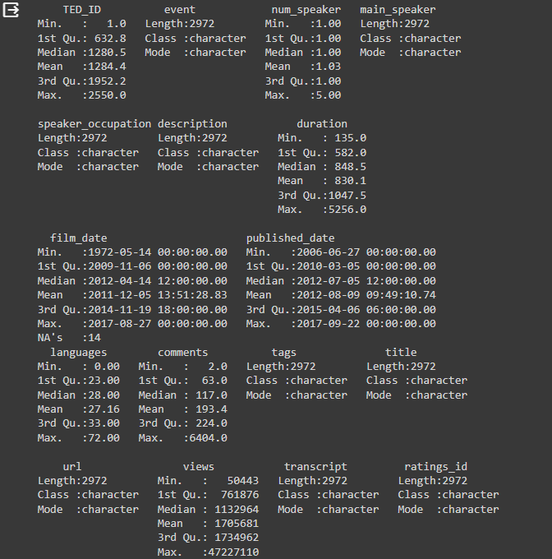
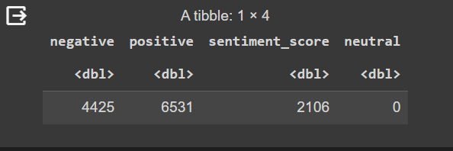
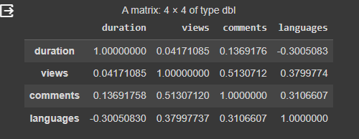
Statistical Analysis

Slide 9
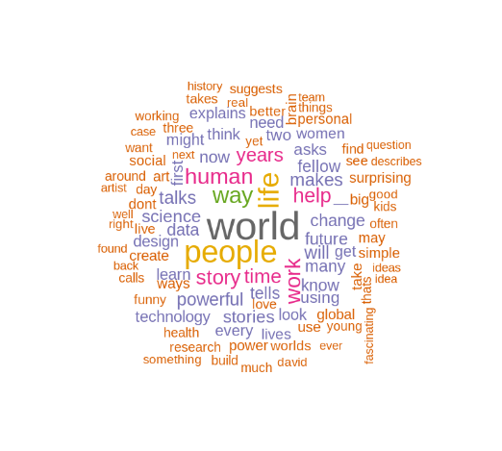
Text Analysis

Slide 10
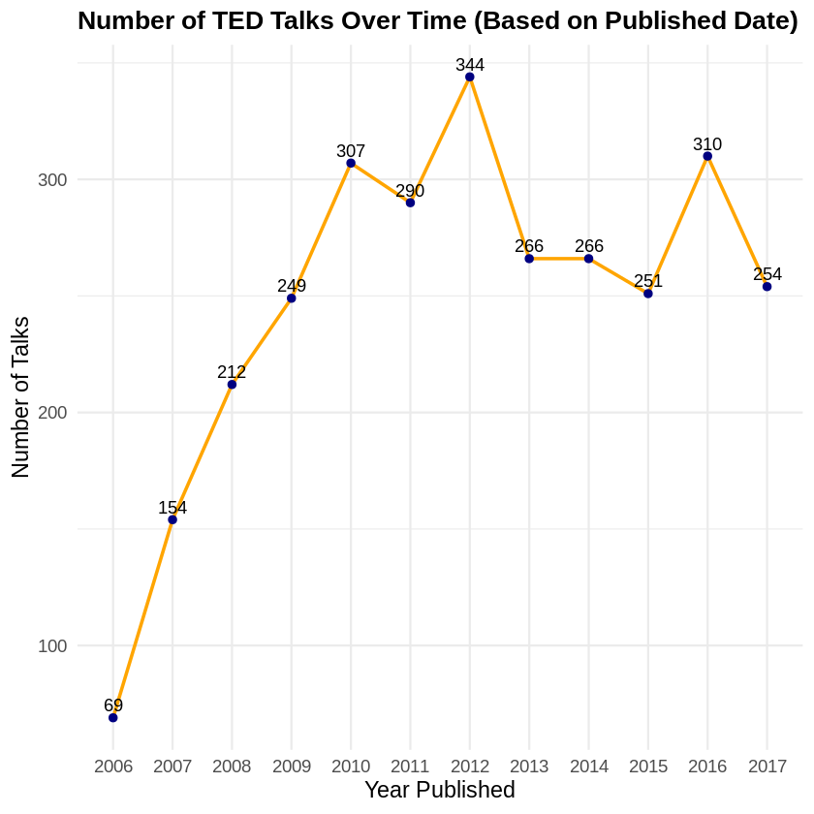

Slide 11
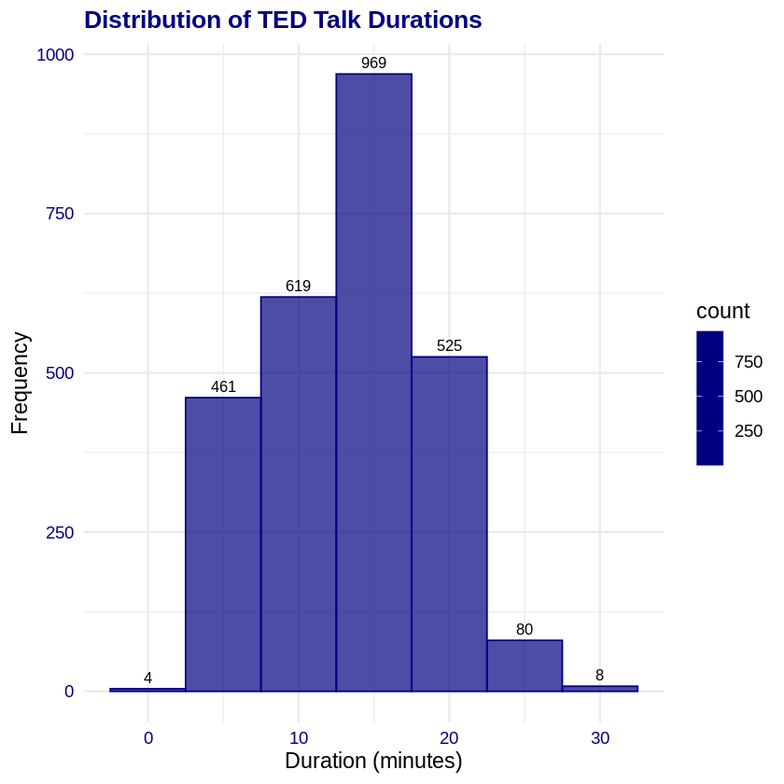

Slide 12
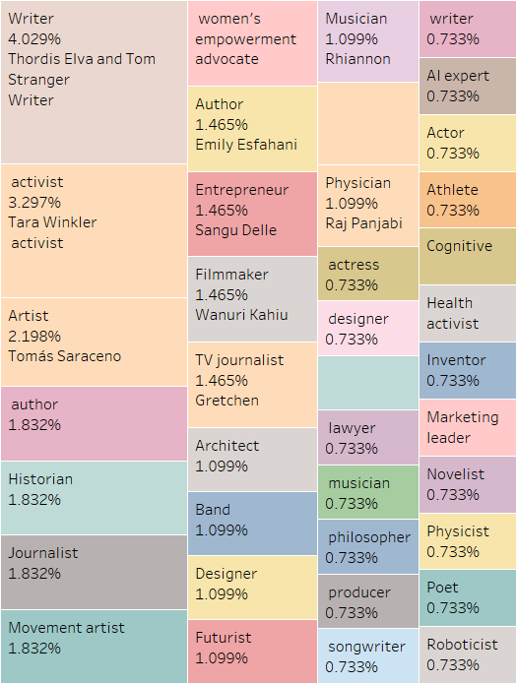
Top shares of talks by speaker occupation type

Slide 13
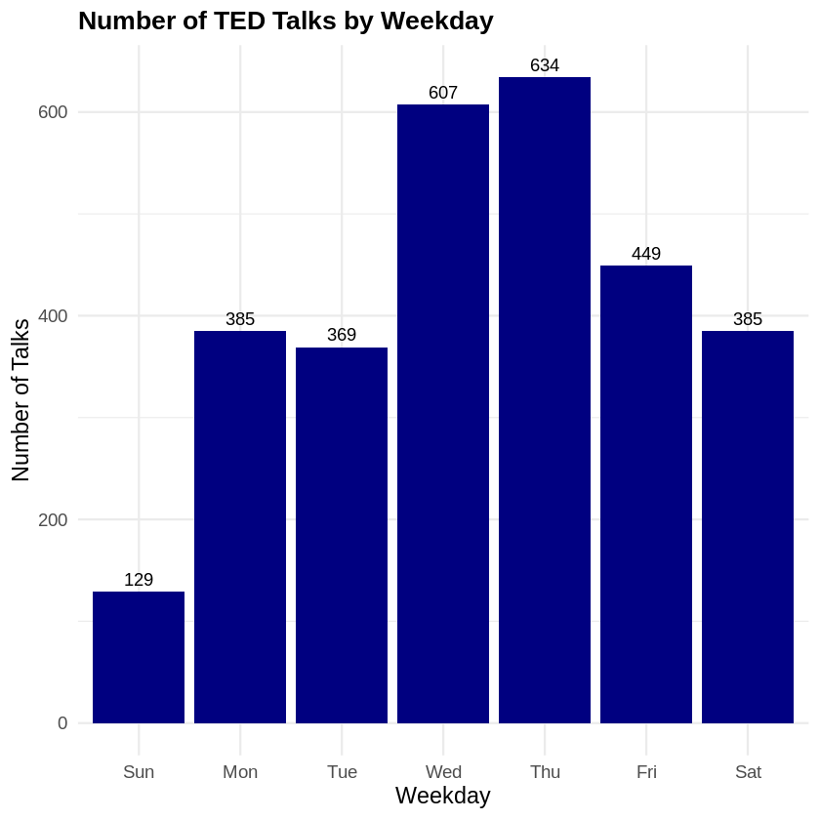
Number of talks published (WeekDay wise)

Slide 14
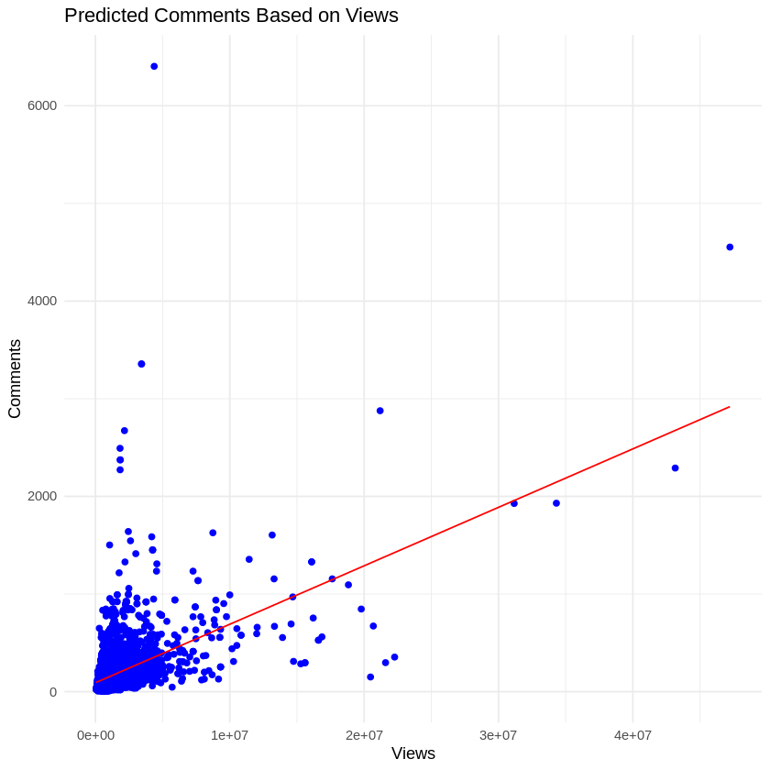
Relation between views and comments

Slide 15
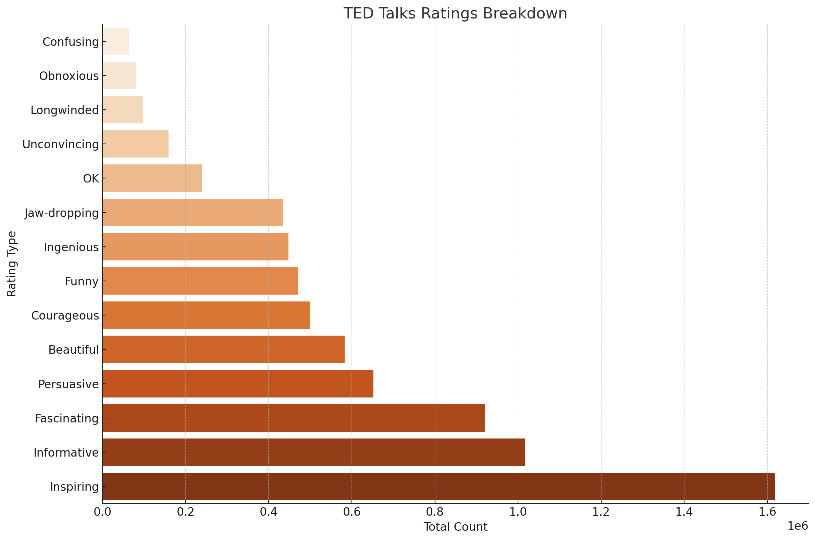
Total count per Individual Rating Type

Slide 16
Challenges
Choosing the dataset Ted Talks
Handling nested structures in the dataset
Learning Tableau
Collaboration challenges

Slide 17

Thank You ☺
Any Questions?

